Slide 1
How do we increase
SAT participation rate?
By Vikas, Cheyanne, David, Alyse
DSI-16

Slide 2
Agenda
Executive Summary
Research Method & Analysis
Key Takeaways
Recommendations
Further Research

Slide 3
Executive Summary
PROBLEM STATEMENT
WHAT WE WILL BE DOING
SAT
ACT
Participation rate
Total Scores
Test Score per Subject
External Research
Key Trends and Insights
Recommendations
There are still many states in the USA which have very low to negligible rate of SAT participation among high schoolers.
There is a need for a focused approach, to improve state level SAT participation across the nation.
DATA ANALYSED:
KEY METRICS:

Slide 4
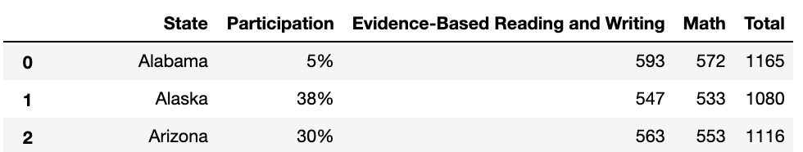
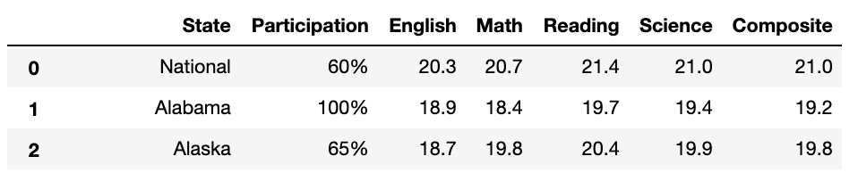
Research Method & Analysis
Data Preparation – Data Description
SAT 2017 Data List
SAT Examination:
Number of subject: 2 (Evidence-based Reading and Writing, Math)
Each component is scored on a scale of 200 to 800.
Total score ranges from 400 to 1600.
ACT 2017 Data List
ACT Examination:
Number of subjects: 4 (English, Math, Reading, Science)
Each component is scored on a scale of 1 to 36.
Average composite score ranges from 1 to 36

Slide 5
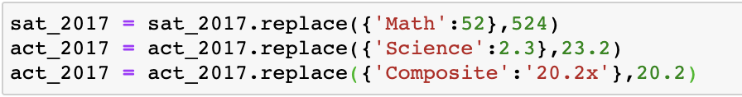
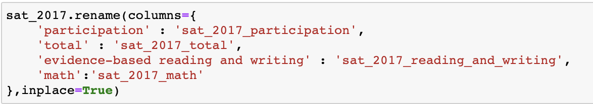
Research Method & Analysis
Data Preparation – Data Cleaning
There were 3 errors found in the data and have been replaced with the correct values.
The data type of participation rates and scores were set to either integer or float.
Column names have been changed to more expressive and unique names.

Slide 6
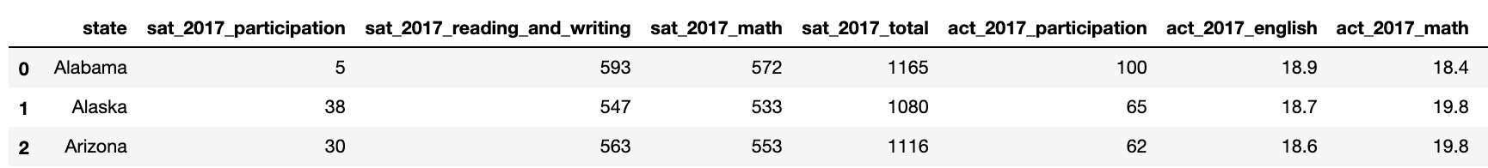
Research Method & Analysis
Data Preparation – Merging Dataframes
The row information for national from act_2017 has been removed
Data from SAT 2017 and ACT 2017 are then combined together and saved as a new file combined_2017.csv.
Same steps were repeated for SAT_2018 and ACT_2018.
2017 and 2018 data were then combined and saved as final.csv.
This file will be used for the rest of investigation and analysis.

Slide 7
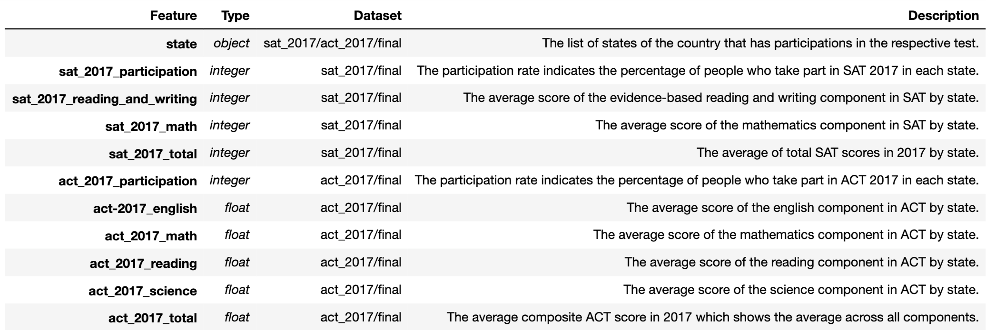
Research Method & Analysis
Data Preparation – Data Dictionary

Slide 8
Research Method & Analysis
Exploratory Data Analysis - Key Trends
 | SAT | ACT
States with Mandatory Testing | <10 | ~20
Lowest participating states (in terms of participation rates %) | Mostly ~0% | 7% - 30%
Largest jump in participation rates (by states, 2017 to 2018) | Illinois: +90% Colorado: +89% | Ohio: +25% Nebraska: +16%
Top 10 scoring states (in terms of participation rates %) | 2% - 4% | 7% - 43%
Bottom 10 scoring states (in terms of participation rates %) | Mostly >90% Outliers: Hawaii(56%), West Virginia (28%), Utah(4%) | Mostly 100% Outliers: Arizona (66%), Hawaii (89%)

Slide 9
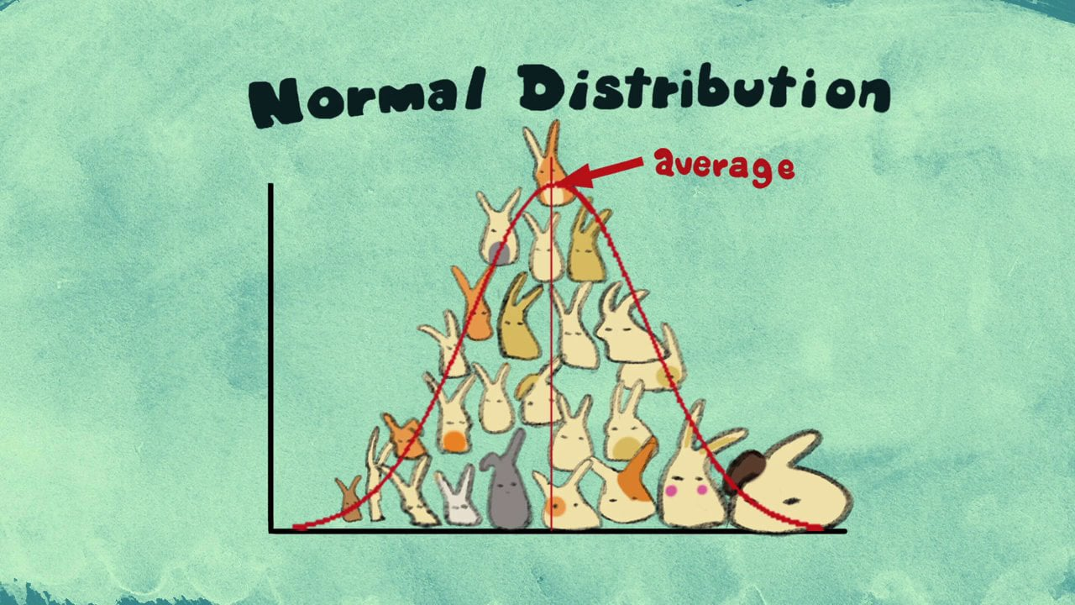
Research Method & Analysis
Exploratory Data Analysis - Statistical Analysis
DOES CENTRAL LIMIT THEOREM HOLD
IN OUR PLOTS?

Slide 10
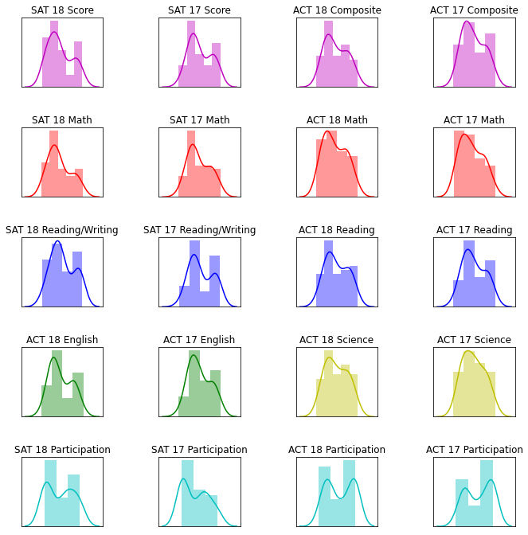
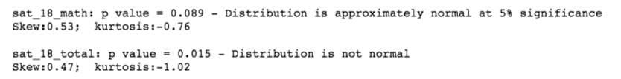
Research Method & Analysis
Exploratory Data Analysis - Statistical Analysis
Which plots are approximately normal?
Using ‘stats.normaltest’ function from scipy stats library, we analyse each plot to see if they are approximately normal at 5% significance level
1
2
1
3
SAT 2018 MATH
SKEW: 0.53
KURTOSIS: -0.76
P-VALUE: 8.9%
ACT 2017 ENGLISH
SKEW: 0.35
KURTOSIS: -0.88
P-VALUE: 8.4%
3
4
2
4
SAT 2017 MATH
SKEW: 0.37
KURTOSIS: -0.93
P-VALUE: 5.6%
ACT 2017 SCIENCE
SKEW: 0.22
KURTOSIS: -0.94
P-VALUE: 7.2%

Slide 11
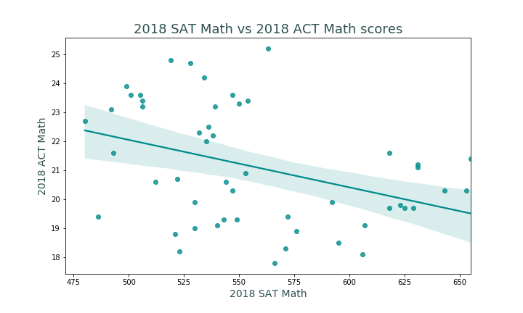
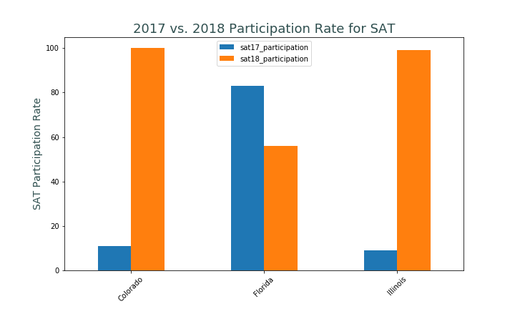
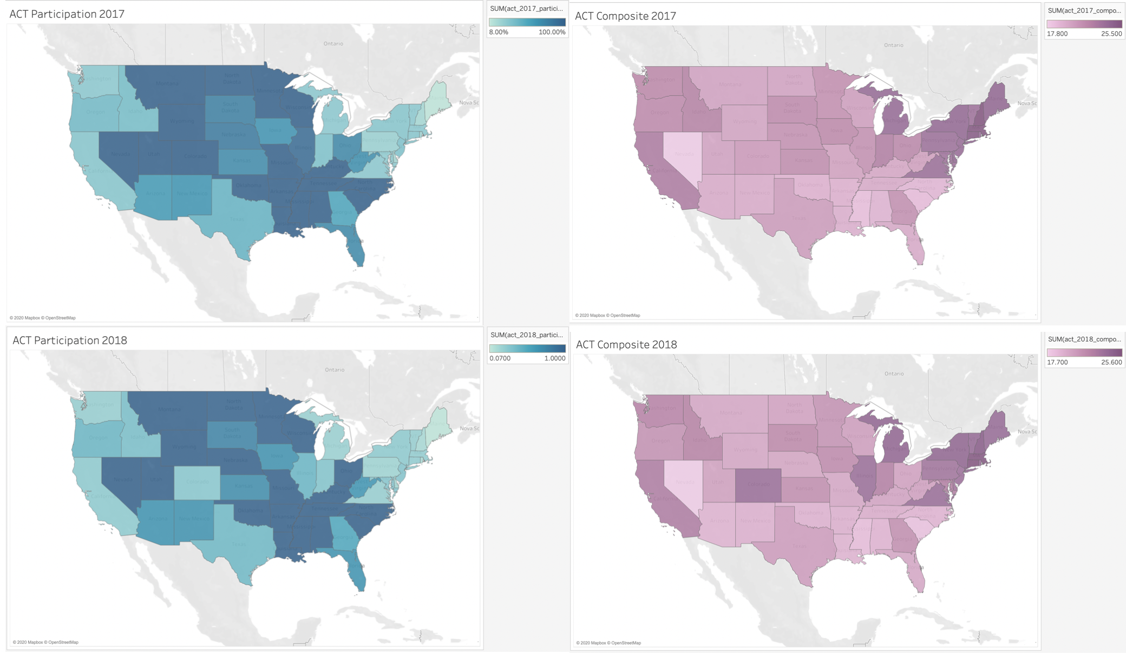
Research Method & Analysis
Data Visualisation
Heatmaps
Histograms
Scatterplots
Boxplots
Bar Charts
Choropleth Maps

Slide 12
Research Method & Analysis
Data Visualization – Key Takeaways
1
High SAT Participation
Low ACT participation
2
1
2
High ACT/SAT Participation
Low ACT/SAT Scores
2
3
3
High ACT/SAT Participation in 2017
High ACT/SAT Participation in 2018
3

Slide 13
Research Method & Analysis
Data Visualization – Key Takeaways
HISTOGRAM ANALYSIS
SAT Participation:
U shape with the bulk of states
at lower participation rates
ACT Participation:
Extremely high number of states with near 100% participation.
Bulk of the rest falls in range of 20 - 40%
BOXPLOT ANALYSIS
SAT Math Scores:
Higher deviation of scores in the top 75% quantile
Students who score well, score exceptionally well.
ACT Math Scores:
Median score is slightly higher than SAT.
Less differentiation of scores amongst high performers
* Above is also true for verbal reasoning

Slide 14
Research Method & Analysis
Data Visualization – Key Takeaways
CHOROPLATH MAP
SAT Participation:
Highly concentrated amongst coastal states
ACT Participation:
Highly concentrated amongst inland states
Massive increase in SAT
participation rates from 2017-2018
My recommendation: South Dakota

Slide 15



Research Method & Analysis
External Research
Notes:
Histogram shows

Slide 16
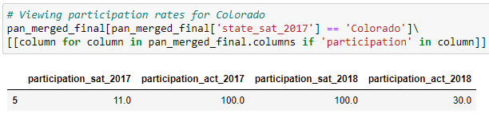
Research Method & Analysis
External Research
Colorado
High ACT participation rates in 2017
Low SAT participation rates in 2017
Low ACT participation rates in 2018
High SAT participation rates in 2018

Slide 17
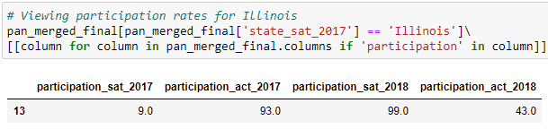
Research Method & Analysis
External Research
Illinois
High ACT participation rates in 2017
Low SAT participation rates in 2017
Low ACT participation rates in 2018
High SAT participation rates in 2018

Slide 18
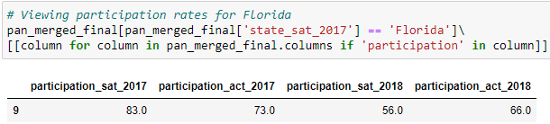
Research Method & Analysis
External Research
Florida

Slide 19
Research Method & Analysis
External Research
Florida
High ACT participation rates in 2017
High SAT Participation rates in 2017
Average ACT Participation rates in 2018
Very High SAT participation rates in 2018
97%
https://reports.collegeboard.org/pdf/2018-florida-sat-suite-assessments-annual-report.pdf

Slide 20
Research Method & Analysis
External Research
Colorado
Illinois
Florida
What do these three states have in common?

Slide 21

Research Method & Analysis
External Research

Slide 22
Research Method & Analysis
External Research
Colorado
Implemented mandatory statewide SAT testing
https://www.denverpost.com/2017/03/06/colorado-juniors-sat-college-exam/
Illinois
Implemented mandatory statewide SAT testing
https://www.chicagotribune.com/news/ct-illinois-chooses-sat-met-20160211-story.html
Florida
Free “school day” event
https://www.orlandosentinel.com/news/education/os-ne-act-sat-florida-scores-20181024-story.html
Notes:
The SAT is replacing the ACT, which had been given to juniors in Colorado since 2001. The state decided to switch test givers in 2015 after lawmakers voted that the Colorado Department of Education must take competitive bids for both a college-entrance exam and a new exam for 10th-graders.
This week, ACT lost its administrative appeal, and the Illinois State Board of Education announced Thursday that it will begin negotiating a contract with the College Board. The nonprofit has been making inroads in the Midwest, though its SAT exam is more widely known on the East Coast.
Officials attributed the increase to many school districts, including those in Central Florida, offering free SAT “school day” events, where teenagers can take the exam during a regular school day with the cost covered by their schools, not their parents.

Slide 23
Key Takeaways
What have we learnt from our data analysis?
1
High Participation in SAT
Low Participation in ACT
2
High Participation
Low Scores
3
Popularity of SAT
Coastal States
Popularity of ACT
Inland States
4
Key drivers for recent growth:
State Sponsorship
School’s Realisation of the value of SAT examination

Slide 24
Recommendations
What are our key criterions for choosing the state of interest?
No ACT mandatory testing
1
1. SOUTH DAKOTA
No existing contract with state as this drastically depresses SAT participation
2. KANSAS
Mid - high ACT participation rate
2
3. IOWA
Shows the examination culture amongst high school students and high schools in the state in taking college-entrance exams
High ACT Composite Scores
3
FILTERED RESULTS
Shows that the generate competency of students in the state is high. This is because SAT is concluded to be slightly tougher than the SAT to do well.
High SAT Average Scores
4
Good track record necessary for any partnership efforts with the education board.
Located near Coastal States
5
Optional: SAT is very popular amongst coastal states. Hence influence to take the SAT is strong.

Slide 25
Recommendations
Suggest to focus our efforts in increasing SAT participation rates in South Dakota
No SAT/ ACT mandatory testing
With voluntary participation, it would be easier to build a relationship with the education board for future collaborations.
1
SOUTH DAKOTA
2
Culture of taking college entrance examinations
Astounding participation rate of 77% in the ACT exam despite not having mandatory testing.
Higher-than-average ACT scores
Despite high ACT participation rate, students perform higher than national average across all ACT subjects. This indicates student’s competency and exam-readiness.
3
Ranked 10th for SAT scores
Exceptional track record helps in building a business case with the education board for partnership opportunities
4
Midwestern State
Located near Illinois and the East Coast states, popularity of the SAT might gradually spread to the Midwest.
5

Slide 26


Recommendations
How can we increase SAT take-up rate?
Marketing Campaigns to increase awareness of SAT
Highlight SAT’s key selling points
To negotiate for state-wide contracts
Subsidies for SAT exams
Weekday testing
Collaboration with schools to align syllabus
More online resources for students
Practice SAT exams
Free online tutoring

Slide 27
Further Research Materials
What additional data do we need for deeper and more insightful research?
Socioeconomic indicators for each state:
High school graduate (%) and College graduates (%)
Household Income
At least 5 years worth of data
Student-level data
Test taken + Test Results
College admitted
City/District-level participation rate for each test

